Slide 1
Food Rescue Network
Atole Rohan Ashok
Seat No.3071
Pawar Aniket Vasant
Seat No.3099

Slide 2
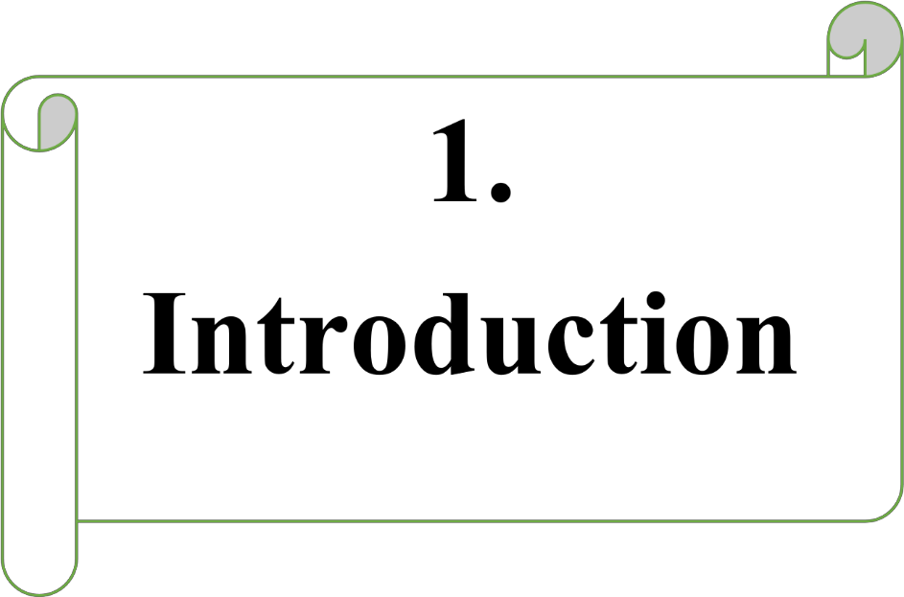

Slide 3
1.1 Introduction System
Food Donation is a mission to end hunger and no waste of food to make a hungry-free world. According to the latest survey, 1.3 billion tons of food is thrown as waste every year. Additionally, one-third of the food consumed is stated as leftovers.
The focus of this project is to reduce the amount of food wasted and being used for needy people. Therefore, a website is developed by which a person can donate food with their capacity, and at the same time, the application lets the organization put their request on their requirements.
Our mission is to bridge the gap between surplus food and hunger by rescuing edible food from various sources and delivering it to community organizations that support individuals and families in need. By doing so, we aim to significantly reduce food waste, mitigate environmental impacts, and enhance food security within our communities.

Slide 4
1.2 Scope of System
According to the research, people are attempting to donate food more frequently through Food Rescue Network Website because they are quicker and save time compared to searching multiple websites for non-proﬁt contact information.
Additionally, we want to grow our project by adding more platforms and contacting delivery services to pick up food, among other things.
The ability to view the real-time location of food deliveries is another feature that raises expectations.
In order to streamline, our system will provide a quicker booking procedure and a quicker reaction to user requests, saving the user time.

Slide 5
1.3 Existing System
Presently people who wish to donate surplus food need to personally visit the organizations and donate foods or other items.
Manual processes and limited technology support are typical of the current food waste management and donation system.
Traditional methods of connecting and coordinating food donations include phone calls, physical visits or word of mouth.
If they do not need the food, then the person has to contact another organization. This makes the donor tired and exhausted.
Increased food waste and financial losses can be caused by this manual approach.
.

Slide 6
1.4.Proposed System
The website for food donation acts as an interface between the users looking for a channel to give the excess food without wasting it.
It enables us to donate the excess food by notifying nearby users with the details of the available food.
The donor’s information is posted on the application and any number of users can claim the food.
The system is designed so that one or more users can claim the food.
The food serving process is based on priority (first come first serve).
Methods of connecting and coordinating food donations is one click from our website.

Slide 7
1.5. Software and Hardware Requirements
Software Requirements –
Operating System | WINDOWS OS (Windows 10, 11)
Frontend | HTML5, CSS, Bootstrap5, JavaScript
Backend | MySQL, PHP
Hardware Requirements –
Processor | Intel inside CORE i5 Processor and Above
RAM | 8 GB and ROM 512 GB
Hard Disk | 500 GB

Slide 8
1.6 Modules
Sign-up and log in: The user has to sign in with the name, email ID, contact number, and address.
Donating the surplus food: The user has to choose the activity if donating or claiming the surplus food. It is required to fill the contact address where the food is available.
Claiming the surplus food: If the user claims for the surplus food, need to specify the organization name with address and contact details.
Priority-based sorting: If one or more user has claimed for food, the request is scheduled on priority bases.
Data Analysis with Graphs: The data gets recorded after every donation and the graph is prepared for visualization impact. This graph is prepared with the focus of increasing donating in the minds of people.
Data Analysis with Reports: Once the data gets recorded, the system generates reports with the total number of people fed and the total quantity of food donated.

Slide 9





Slide 10
2.3 Fact Finding Techniques
At the time of the analysis of the system or before starting the actual work of the system the system analyst has to collect information about the manual system from the user department for which the system will be developed. To collect this information, the system analyst prefers anyone of the following fact-finding technique or prefers two or more fact-finding techniques according to the situation:
1. Examining Documentation:
- Project proposal: "Food Rescue Network: Reducing Food Waste and Feeding the Hungry"
- Project plan: Outlines goals, objectives, timelines, and resources required
- Meeting minutes: Notes from meetings with stakeholders, including food donors, recipient organizations, and volunteers
- Reports: Monthly reports on food rescue metrics, including pounds of food rescued, number of meals provided, and demographics of recipients.
2. Interviews
- Food Donors:
- What motivates you to donate food to the Food Rescue Network?
- What types of food do you typically donate?
- How do you currently handle surplus food?

Slide 11
Recipient Organizations:
- How do you currently receive food from the Food Rescue Network?
- What types of food do you need most?
- How do you distribute food to those in need?
- Volunteers:
- What motivates you to volunteer with the Food Rescue Network?
- What tasks do you typically perform as a volunteer?
- How do you think the Food Rescue Network could improve?
3. Observation
- Food Rescue Operations:
- Observe food pickup and delivery processes
- Note efficiency and effectiveness of operations
- Identify areas for improvement
- Recipient Organizations:
- Observe food distribution processes
- Note effectiveness of food distribution
- Identify areas for improvement

Slide 12
4. Research
- Food Waste Statistics:
- Research national and local statistics on food waste
- Identify trends and patterns
- Food Insecurity Statistics:
- Research national and local statistics on food insecurity
- Identify trends and patterns
- Best Practices:
- Research best practices in food rescue and distribution
- Identify innovative solutions and technologies
5. Questionnaires
- Food Donor Questionnaire:
- What types of food do you typically donate?
- How often do you donate food?
- What motivates you to donate food?
- Recipient Organization Questionnaire:
- What types of food do you need most?
- How often do you receive food from the Food Rescue Network?
- How do you distribute food to those in need?

Slide 13
2.4 Feasibility of the System:
  A feasibility study is a preliminary exploration of a proposed project or undertaking to determine its merits and viability.
  A feasibility study is an assessment of the practicality of a project or system.
  A feasibility study is an assessment that determines the likelihood of a proposed project being successful, such as a new product line or technical system.
Types of feasibility studies
1. Technical feasibility
2. Economic feasibility
3. Operational feasibility
1.Technical Feasibility
Analyze the technical skills and capabilities of software development team member.
Determine if the relevant technology is stable and established.

Slide 14
2. Economic Feasibility
The costs incurred in software development generate long-term benefits for an organization.
Costs required to conduct a complete software study (e.g., requirements extraction and requirements analysis).
Hardware, software, development team, and training costs.
3. Operational Feasibility
Determine if the expected issue in the user request is a high priority.
Determine if the organization is satisfied with alternative solutions proposed by the software development team.
Determine if the solution proposed by the software development team is acceptable.
Analyze whether users are comfortable with new software.

Slide 15





Slide 16
3.1 E. R Diagram
ID
Password
Login
1
has
Name
Type
Quantity
1
Donor
1
Donate
M
Food
M
Accept
1
M
Addr
Gmail
Category
View
Name
Day
Username
M
Collect
1
1
History
Quantity
Admin
1
1
M
Date
Password
View
1
Assign Food
Manage
1
1
Charity
M
M
Name
Donor Record
Gov Res No
Addr
Delete
Update

Slide 17
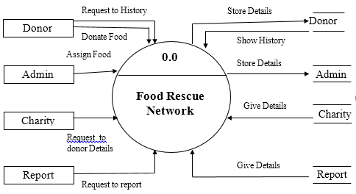
3.2 Context level Diagram

Slide 18
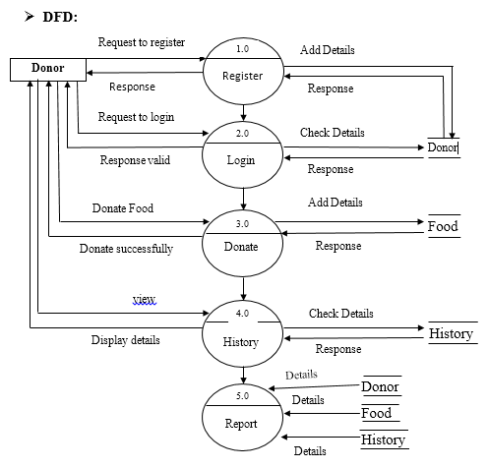
3.3 DFD Diagram

Slide 19
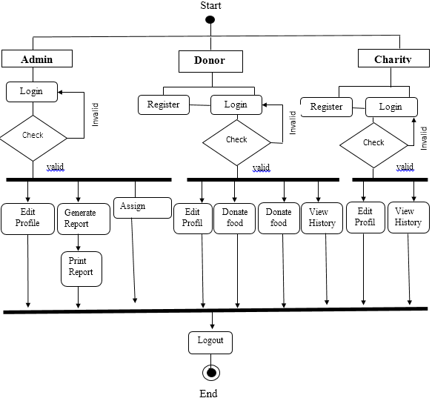
3.6. Activity Diagram

Slide 20
3.7. Sequence Diagram
Donor
Web browser
Web server
Database server
1.1 Enter Registration Details()
1.2 Send Details( )
1.3 Add Details ( )
1.6 Registration Successfully
1.5 Response (valid )
1.4 Response( )
2.1 Enter Login Details()
2.2 Send Details( )
2.3 Check Details( )
2.6 Login Successfully
2.5 Response (valid )
2.4 Response( )
3.1 Donate Food ()
3.2 Send Details( )
3.3 Add Details ( )
3.6 Donate Food Successfully
3.5 Response (valid )
3.4 Response( )
4.1 Logout ()
4.2 Logout Successfully
X
X
X
X

Slide 21
Admin
Web browser
Web server
Database server
1.1 Enter Login Details()
1.2 Send Details( )
1.3 Check Details ( )
1.6 Login Successfully
1.5 Response (valid )
1.4 Response( )
2.1 Assign Food ()
2.2 Send Details( )
2.3 Add Details( )
2.6 Assign Food Successfully
2.5 Response (valid )
2.4 Response( )
3.1 Edit Profile ()
3.2 Send Details( )
3.3 Add Details ( )
3.6 Edit profilr Successfully
3.5 Response (valid )
3.4 Response( )
4.1 Logout ()
4.2 Logout Successfully
X
X
X
X

Slide 22
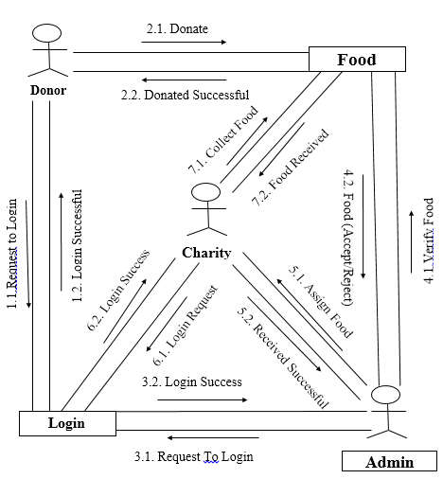
3.8. Collaboration Diagram

Slide 23
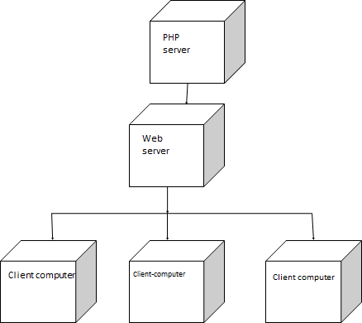
3.9. Deployment Diagram

Slide 24
3.10. Use Case Diagram For Admin and Donor:
Register
Login
Edit Profile
Donate Food
Donate Money
Admin
View History
Donor
Feedback
Report
Logout

Slide 25
Use case For Admin:
Use Case For Donor:
Register
Login
Login
Edit Profile
Edit Profile
View History
Donate Food
Report
Donate Money
Admin
Donor
View History
Logout
Feedback
Logout

Slide 26
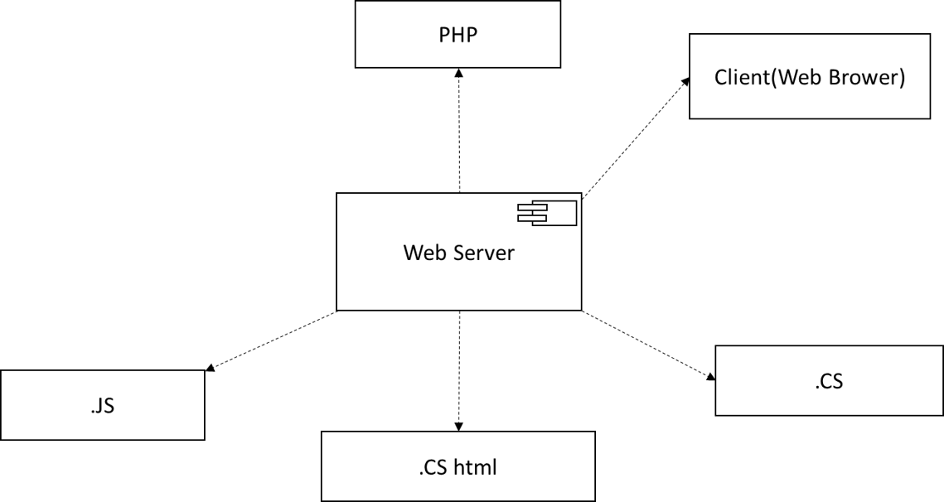
3.12 Component Diagram

Slide 27
3.13. Class Diagram:
Admin
Charity
Donor
A_name
A_phno
A_email
1
*
C_name
C_phno
C_email
D_name
D_phno
D_email
1
*
Login()
Assignfood()
Logout()
Login()
Takefood()
Logout()
Login()
Donatefood()
Logout()
1
*
Food
Donate
F_name
F_category
F_date
F_quentity
Donate_Id
Address
Food_Name
*
*
View()
View()

Slide 28
3.14. Object Diagram:
Admin
Charity
Donor
A_name=”ram”
A_phno=”77698753”
A_email=”ram@gamail.com
1
C_name=”tata trust”
C_phno=”76876767”
C_email=”tata@gmail.com”
D_name=”Aniket”
D_phno=”8345606”
D_email=”ap@gamil.com”
*
1
*
1
*
Food
Donate
F_name=”rice”
F_category=”coocked”
F_date=”10/08/2024”
F_quantity=”10KG”
Donate_Id=”1”
Address=”Baramati”
Food_Name=”rice”
*
*

Slide 29


Slide 30
Admin Table:
S.r No | Field Name | Data Type | Constraint | Field Length | Description
1 | id | INT | PRIMARY KEY | - | Unique identifier for the admin
2 | username | VARCHAR | NOT NULL | 50 | Admin's username
3 | password | VARCHAR | NOT NULL | 100 | Admin's password

Slide 31
Donor Table:
S.r No | Field Name | Data Type | Constraint | Field Length | Description
1 | Donor_id | INT | PRIMARY KEY | - | Unique identifier for the Donor
2 | name | VARCHAR | NOT NULL | 100 | Donor's name
3 | email | VARCHAR | NOT NULL | 100 | Donor's email address
4 | Phone | VARCHAR | NOT NULL | 20 | Donor's phone number
5 | address | VARCHAR | NOT NULL | 200 | Donor's address

Slide 32
Charity:
S.r No | Field Name | Data Type | Constraint | Field Length | Description
1 | id | INT | PRIMARY KEY | - | Unique identifier for the charity
2 | name | VARCHAR | NOT NULL | 100 | Charity's name
3 | email | VARCHAR | NOT NULL | 100 | Charity's email address
4 | mobile | VARCHAR | NOT NULL | 20 | Charity's phone number
5 | address | VARCHAR | NOT NULL | 200 | Charity's address

Slide 33
Food Table:-
S.r No | Field Name | Data Type | Constraint | Field Length | Description
1 | id | INT | PRIMARY KEY | - | Unique identifier for the food item
2 | name | VARCHAR | NOT NULL | 100 | Name of the food item
3 | category | VARCHAR | NOT NULL | 50 | Category of the food item
4 | Expiration | DATE | NOT NULL | - | Expiration date of the food item
5 | Quantity | INT | NOT NULL | 50 | Quantity of the food item

Slide 34
Contact us
Sr. No | Field Name | Data Type | Constraint | Field Length | Description
1 | Contact_id | INT | Primary Key | - | Unique identifier for the history record
2 | Email | VARCHAR | NOT NULL | 100 | Email for user
3 | Subject | VARCHAR | NOT NULL | 100 | Subject for contact us
4 | message | VARCHAR | NOT NULL | 200 | Message for Admin

Slide 35






Slide 36
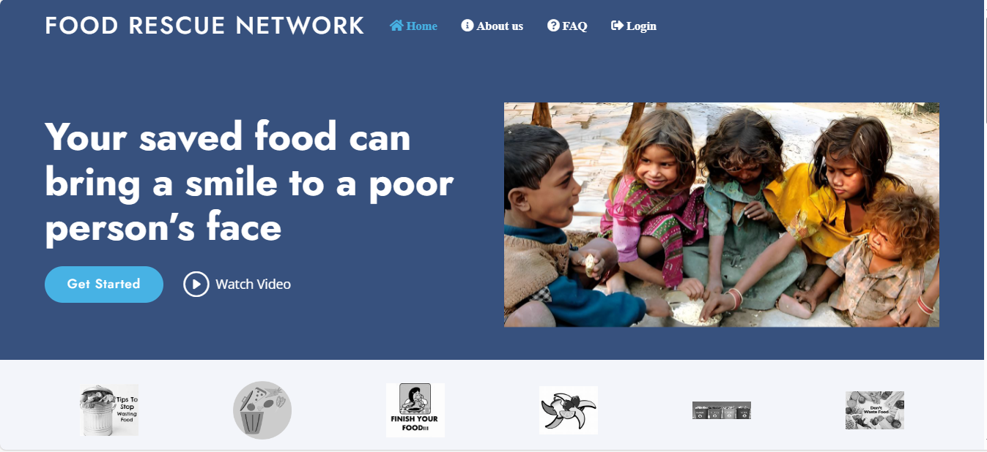
Home/Index page:

Slide 37
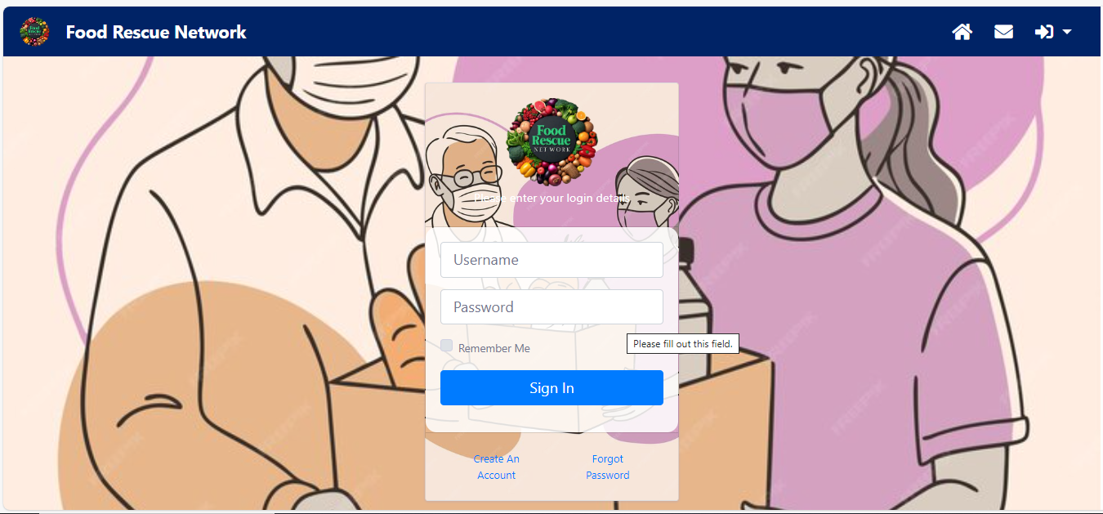
Donor Login:

Slide 38
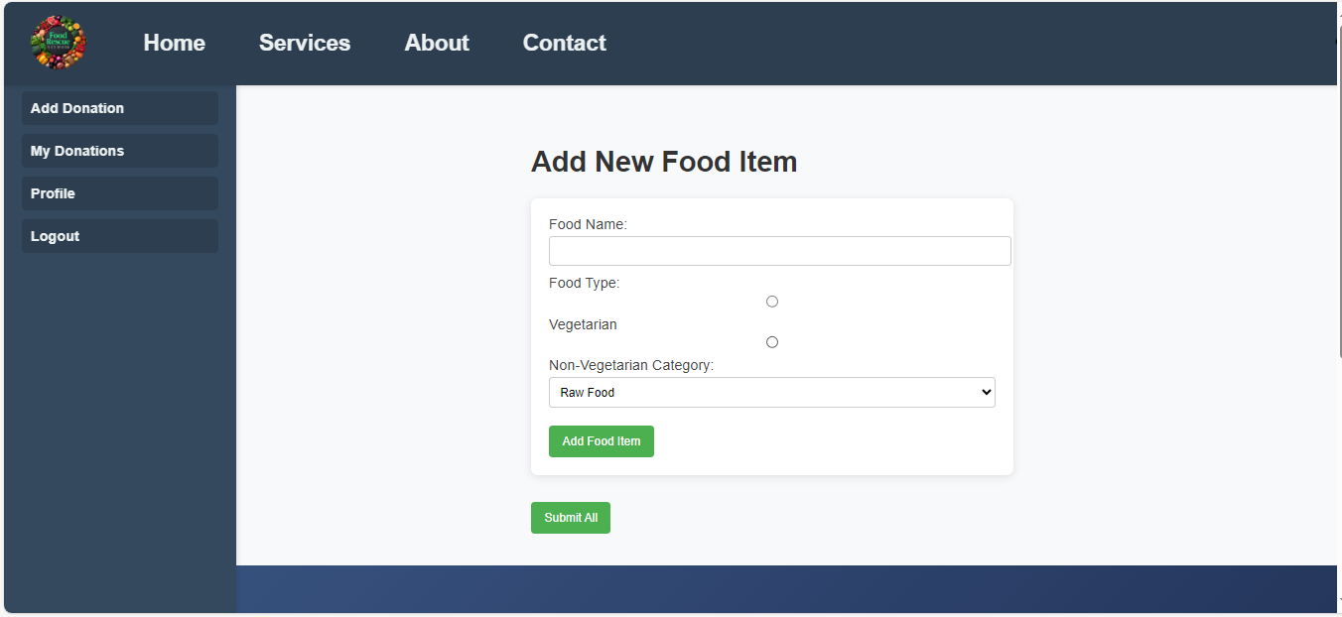
Donor Dashboard:

Slide 39
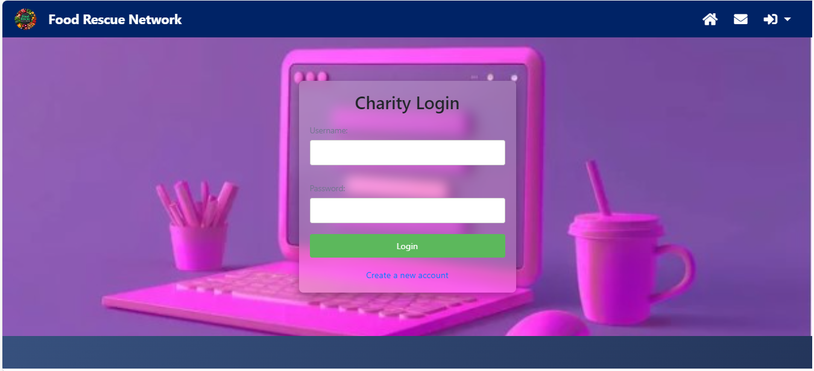
Charity Login:

Slide 40
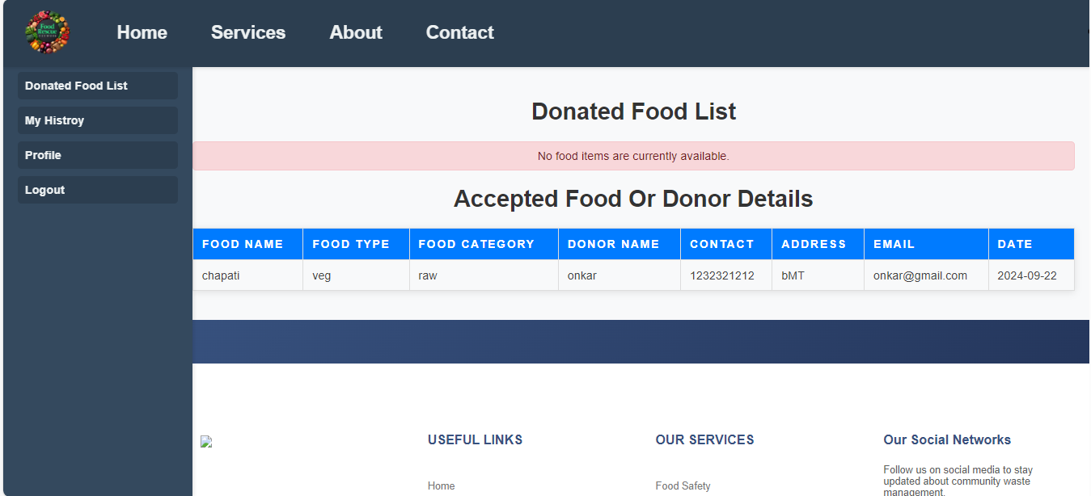
Charity Dashboard:

Slide 41
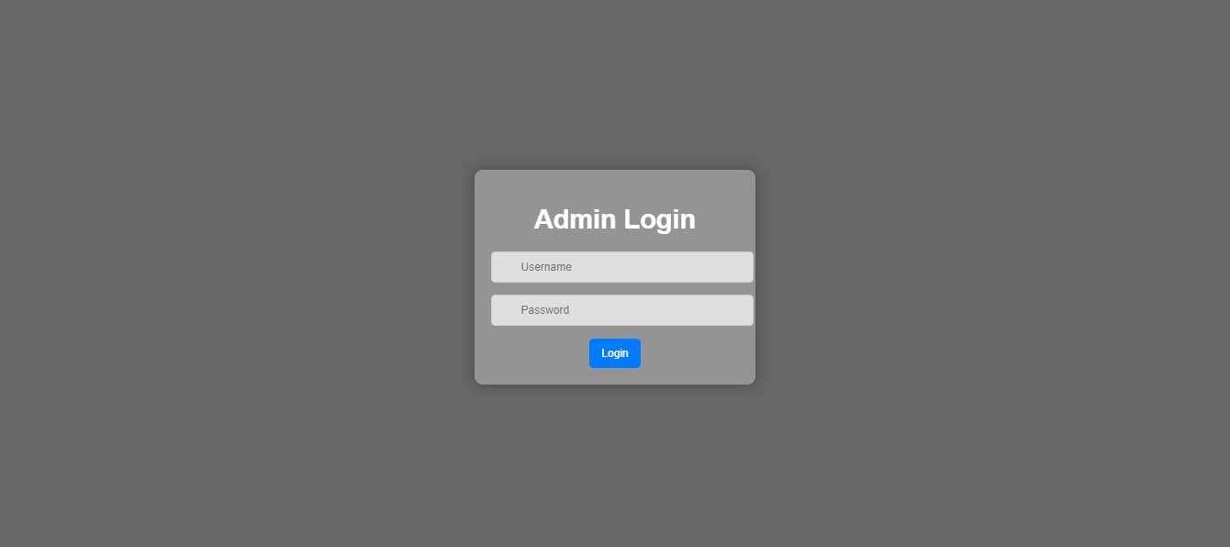
Admin Login:

Slide 42
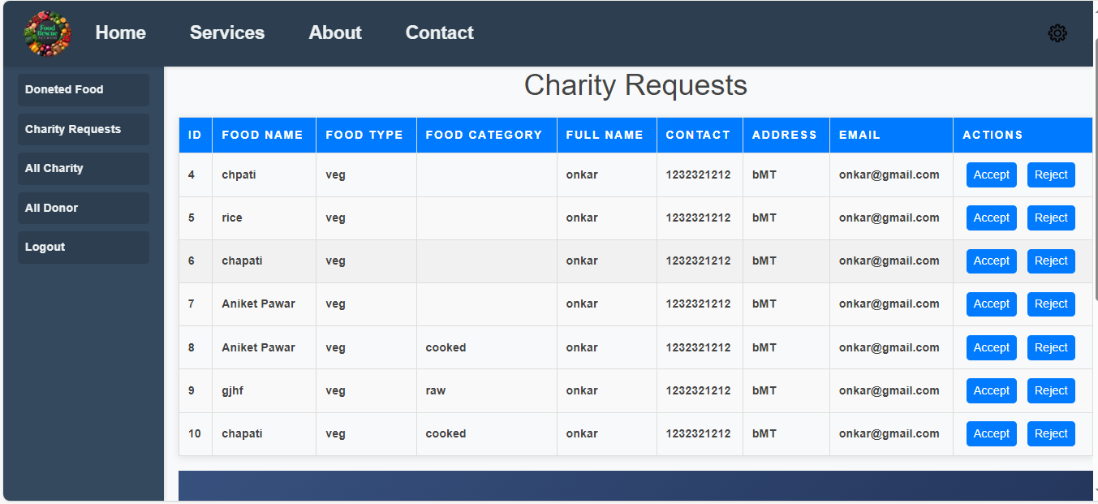
Admin Dashboard:

Slide 43
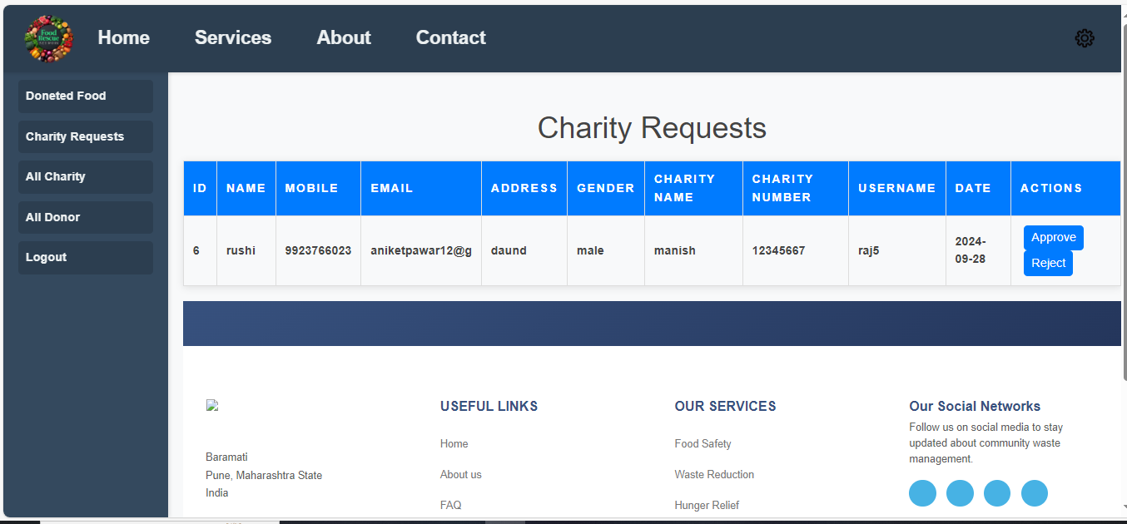
Charity Request in Admin:

Slide 44
6.Reports

Slide 45
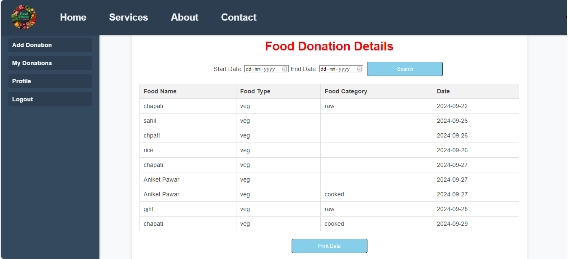
Food Donation Report:

Slide 46
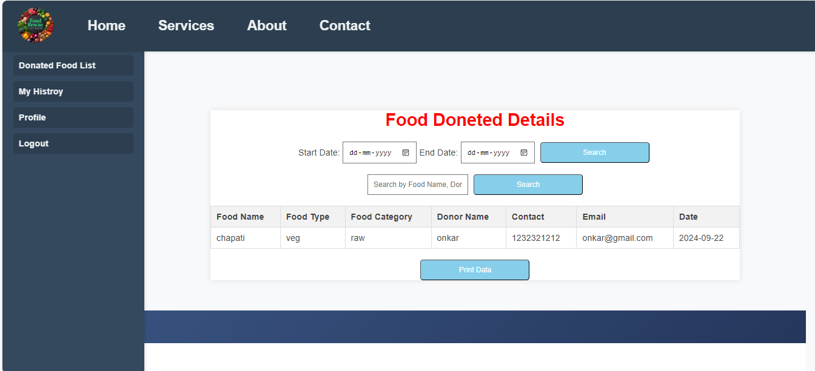
Donated Food in Charity:

Slide 47
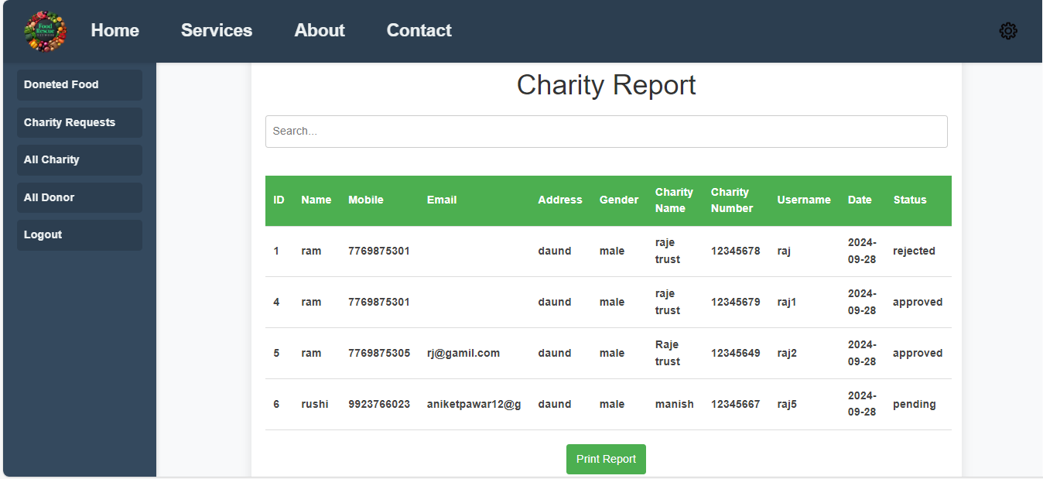
All Charities in Admin:

Slide 48
7.Conclusion
The Food Rescue Network project has successfully highlighted the critical need for collaboration in addressing food waste and hunger. By connecting food donors, organizations, and volunteers, we have created a sustainable system that not only minimizes food surplus but also ensures that nutritious meals reach those in need. Our efforts have fostered community engagement, raised awareness about food insecurity, and demonstrated the positive impact of resource sharing. Moving forward, we remain committed to expanding our reach, enhancing our processes, and inspiring more individuals and businesses to join the fight against food waste. Together, we can continue to make a significant difference in our communities, promoting a more equitable and sustainable food system for all.

Slide 49
8. Future Enhancement
Email verification
Deploy website
Add money donation system

Slide 50
9. Bibliography
www.Google.com
www.chatgpt.com
www.you.com
www.w3school.com
You tube channel: Code with Harry

Slide 51

10. Annexure (Sample Code)

Slide 52
<!DOCTYPE html>
<html lang="en">
<head></head>
<body>
<header id="header" class="fixed-top">
<div class="container d-flex align-items-center">
<h1 class="logo me-auto"><a href="index.html">Food Rescue Network</a></h1>
<nav id="navbar" class="navbar">
<ul>
<li><a class="nav-link scrollto active" href="#hero"><span class="fa fa-home"> Home </span></a></li>
<li><a class="nav-link scrollto" href="#about"><span class="fa fa-info-circle" aria-hidden="true"> About us</span></a></li>
<li><a class="nav-link scrollto" href="#faq"><span class="fa fa-question-circle"> FAQ</span></a></li>
<li class="dropdown">
<a class="nav-link scrollto" href="#" onclick="toggleDropdown()"><span class="fas fa-sign-out-alt"> Login</span></a>

Slide 53
<ul id="loginDropdown" class="dropdown-menu">
<li><a href="donorlogin.php">Donor Login</a></li>
<li><a href="charitylogin.php">Charity Login</a></li>
</ul>
</li>
</ul>
<i class="bi bi-list mobile-nav-toggle"></i>
</nav><!-- .navbar -->
</div>
</header><!-- End Header -->
</body>
</html>

Slide 54
THANK YOU !!

